Slide 1

(garbled expletive) or DEEP Q*BERT
Patrick Nemeth
BrainStation Data Science Bootcamp
May 2024

Slide 2
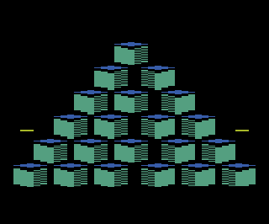
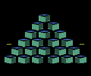
Problems
- This project aims to leverage the chaotic nature of the 1982 arcade game “Q*Bert” to test and improve AI decision-making and to demonstrate how reinforcement learning can be applied to complex, non-linear environments where traditional algorithms struggle."
- I aim to illustrate the potential of AI to learn and adapt in complex scenarios, offering insights that could be transferred to real-world applications such as smart navigation systems, advanced robotics, and adaptive software solutions
- Harnessing the power of Deep Q-Networks, this capstone project teaches an AI agent to play Q*bert inside Python, focusing on adaptive learning and strategic planning to master the game through self-guided trials and accumulated experience.

Slide 3
High level dataset overview
- OpenAI Gym: a comprehensive toolkit for developing and comparing reinforcement learning algorithms. It provides a standardized API and a variety of environments simulating classic games, including the Atari 2600, and many others."
- The Atari Environment: Among the diverse environments offered, the Atari simulations stand out for their complexity and suitability for deep learning tasks. These environments replicate classic Atari 2600 games, offering a rich field for AI experimentation.
- For this project, I focus on “Q*bert”, an Atari game where the agent learns to navigate a pyramid of cubes. This game poses unique challenges that make it an ideal testbed for our reinforcement learning model."

Slide 4
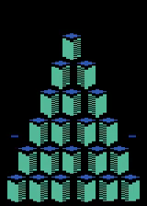

Random agent!

Slide 5
Understanding the Q*bert Learning Environment
Environment:
The game of Q*bert itself, simulated in Python via Gymnasium's Atari environment.
Provides scenarios (states) and responds to the agent’s actions with changes in the game (new state) and feedback (reward).
Observation Space:
What the agent sees from the environment. In Q*bert, this takes the form of a tuple containing RGB pixel information as well as a dictionary of metadata relevant to the game state (Lives lost, etc)
Shows the position of Q*bert, enemies, and the pyramid’s cube colors.
Actions:
1. Explanation: What the agent can do. In Q*bert, there are six actions the agent can take,
0: NOOP (No operation), 1: FIRE. 2: UP, 3: RIGHT, 4: LEFT 5: DOWN
Rewards:
Feedback from the environment to guide the agent’s learning. In Q*bert, rewards are points gained by changing cube colors, avoiding enemies, or catching bonuses.
Rewards are structured to encourage the agent to change all cubes to the target color efficiently while avoiding or tricking enemies.

Slide 6
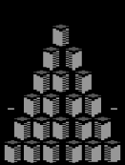
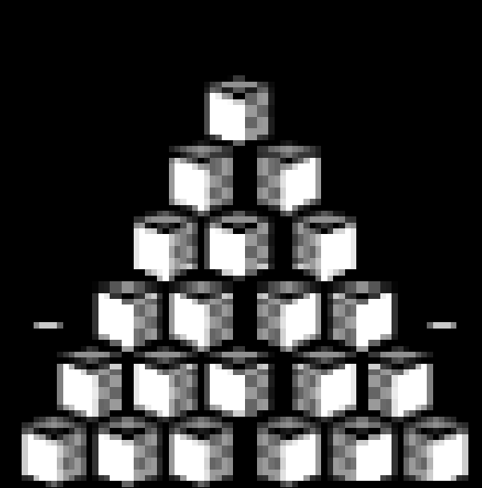
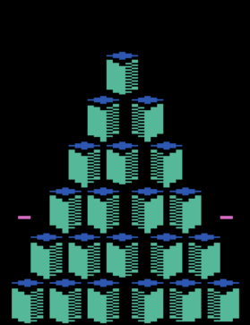
Preprocessing Steps:
Frame Extraction
Grayscale Conversion
Image Resizing
Frame Stacking
x4

Slide 7
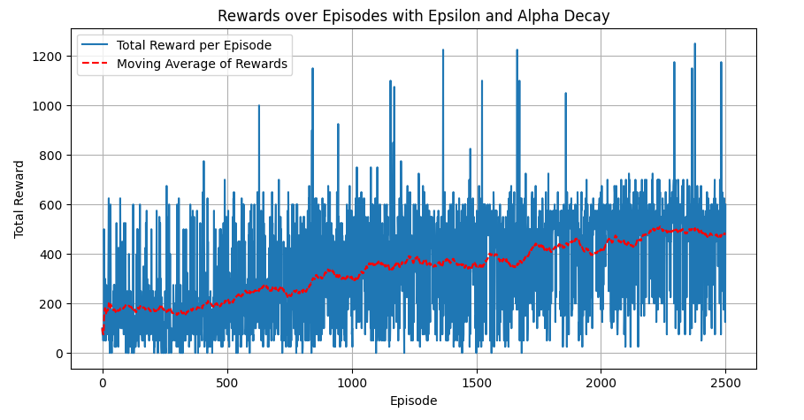
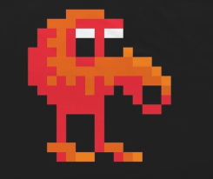
Model Progression:
Q-Learning: Started with the foundational Q-learning algorithm, suitable for learning a policy directly from the environment's rewards. Adjusted hyperparameters to improve performance
Double Q-Network: Transitioned to Double Q-Learning to address potential overestimation of action values seen in Q-Learning. Results inconclusive.
DQN Upgraded to DQN to leverage deep learning for approximating the Q-function, allowing better handling of the game's visual and strategic complexity.

Slide 8
Demonstration of the Learning Process:

Slide 9
Next Steps:
Build an app that allows the user to play the game side by side “against” the various agents that were trained in this project
Explore even more advanced RL methodologies such as DDQN (double deep Q network ) or Duelling Deep Q Networks
Develop a framework to introduce more complex game environments

